Slide 1
OFFSHORE DEVELOPMENT COMPANY
DEVELOPING OUR PEOPLE
GROWING OUR BUSINESS
EPCI&C CONTRACTOR FOR OFFSHORE & ONSHORE PETROLEUM/ENERGY INDUSTRY PROJECTS

Slide 2
ABOUT US
TASDID is one of Iranian leading regional petroleum/energy (upstream/downstream) service companies
Established in 1981 by SADID INDUSTRIAL GROUP in partnership with Iranian Offshore Engineering & Construction Company (IOEC)
SADID INDUSTRIAL GROUP

Slide 3
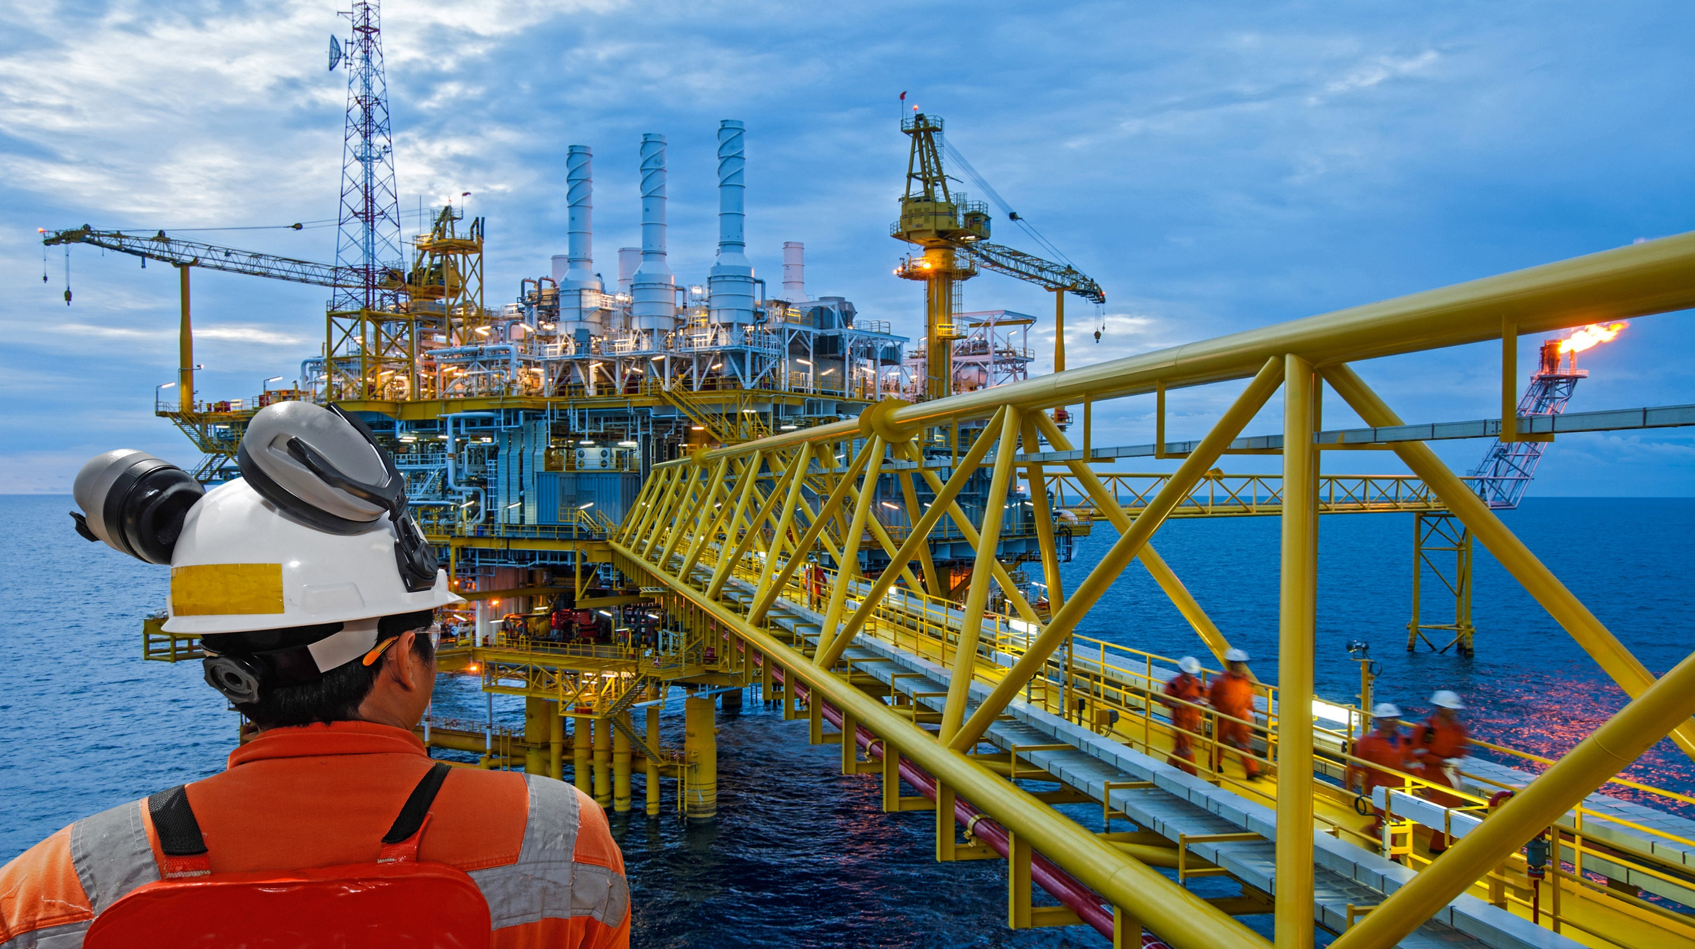
TASDID equipped with dedication and expertise of its people provided a range of marine structure development services by entering into and implementing petroleum (oil, gas …)/energy (power plants …) projects
As TASDID grew in past years we have become a focused engineering and
construction firm participating in tenders in Iran, Meddle East and overseas countries

Slide 4
CAPABILITIES
Petrochemical Plant Design and Procurement

Slide 5
CAPABILITIES
Equipment and Facilities Maintenance, Repair and Renovation

Slide 6
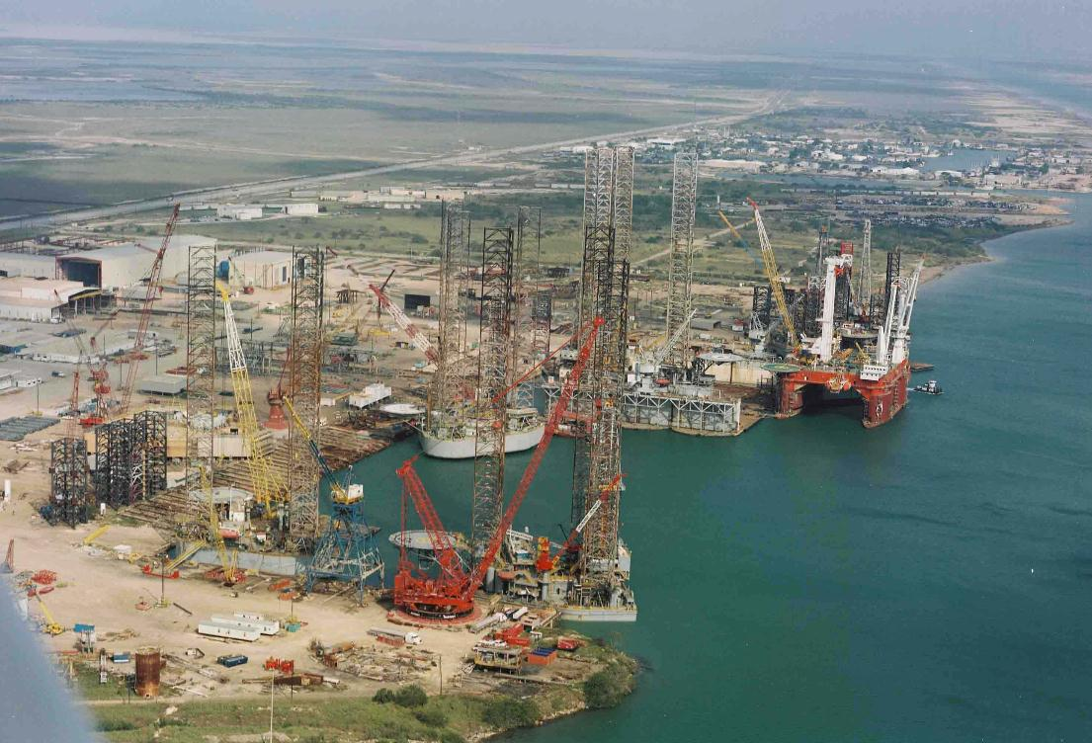
CAPABILITIES
Jackup Design and Fabrication

Slide 7
CAPABILITIES
Wellhead Design and Construction

Slide 8
CAPABILITIES
Pipeline, Subsea Cable Design and Installation

Slide 9
CAPABILITIES
Subsea Equipment Design

Slide 10
CAPABILITIES
Platform Design

Slide 11
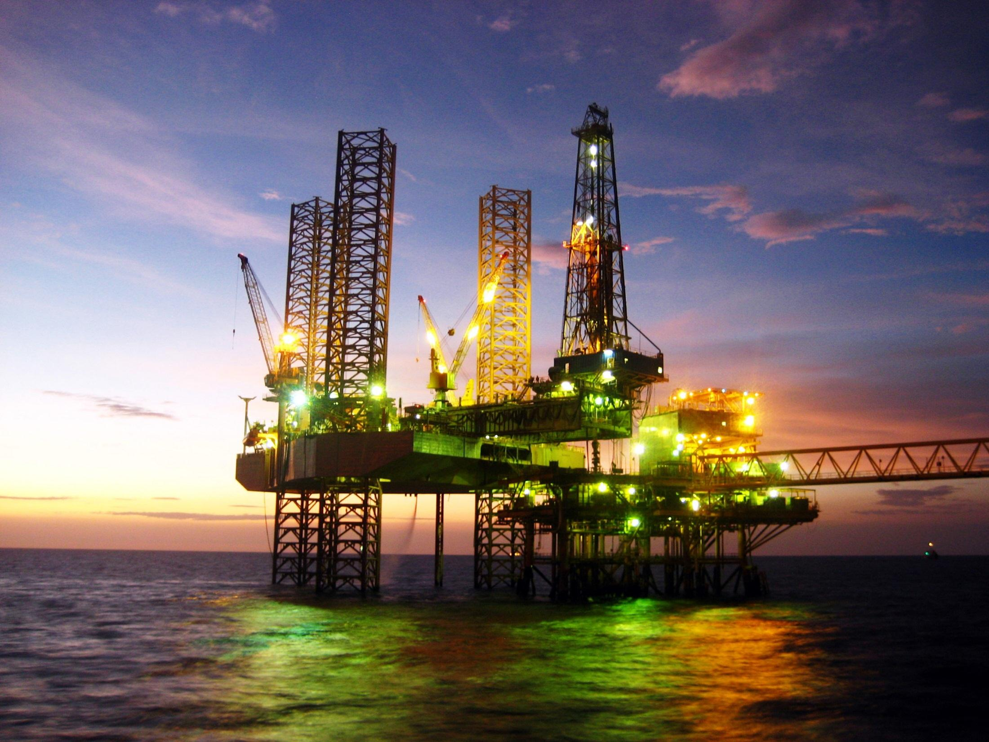
CAPABILITIES
Offshore Drilling Rig Design

Slide 12
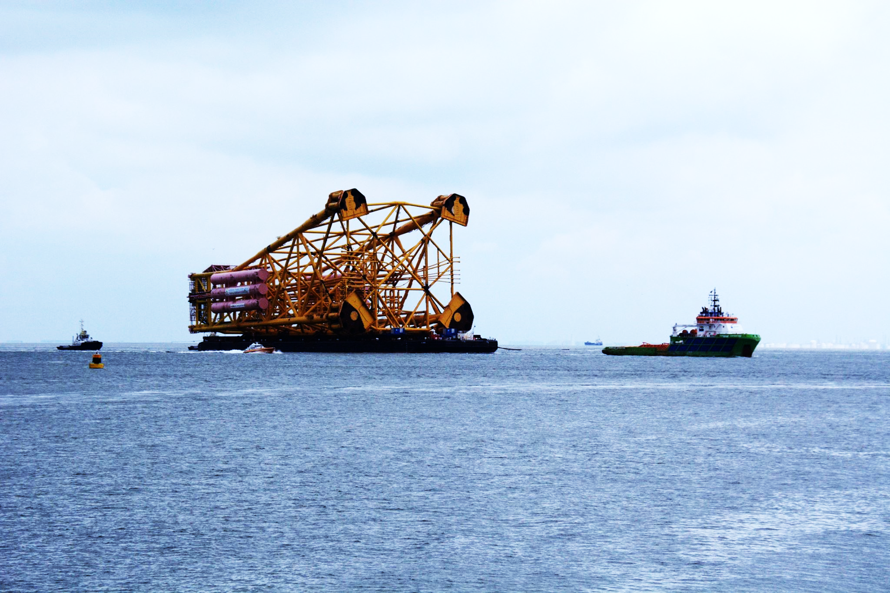
CAPABILITIES
Pre-installation, Installation and Commissioning of Subsea Structures

Slide 13
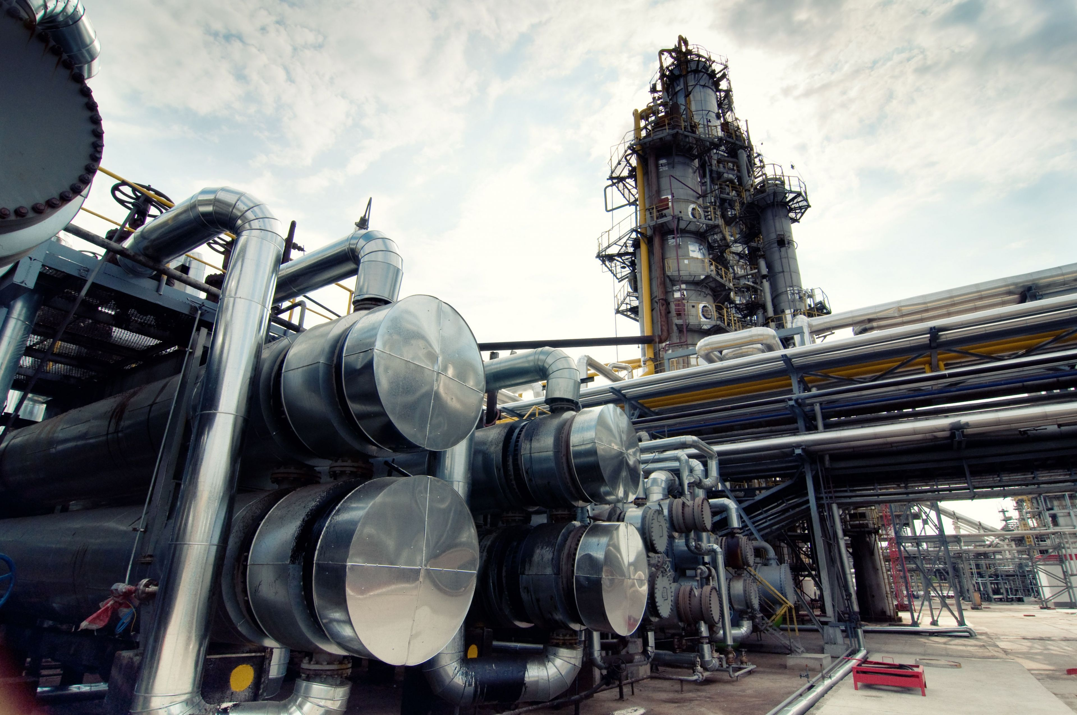
CAPABILITIES
On/Offshore Equipment Design and Procurement

Slide 14
CAPABILITIES
Renewable Projects

Slide 15
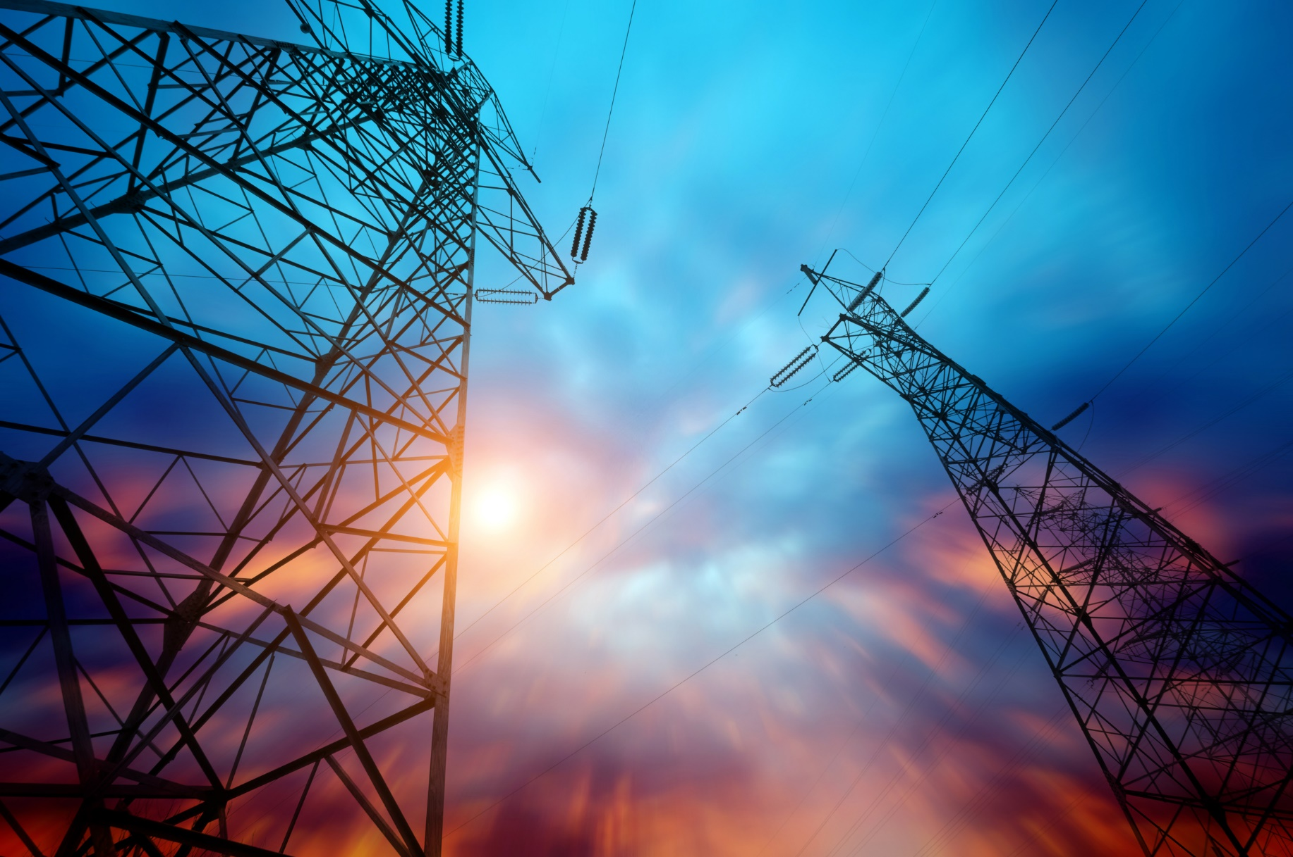
CAPABILITIES
Power Plant Design and Construction

Slide 16
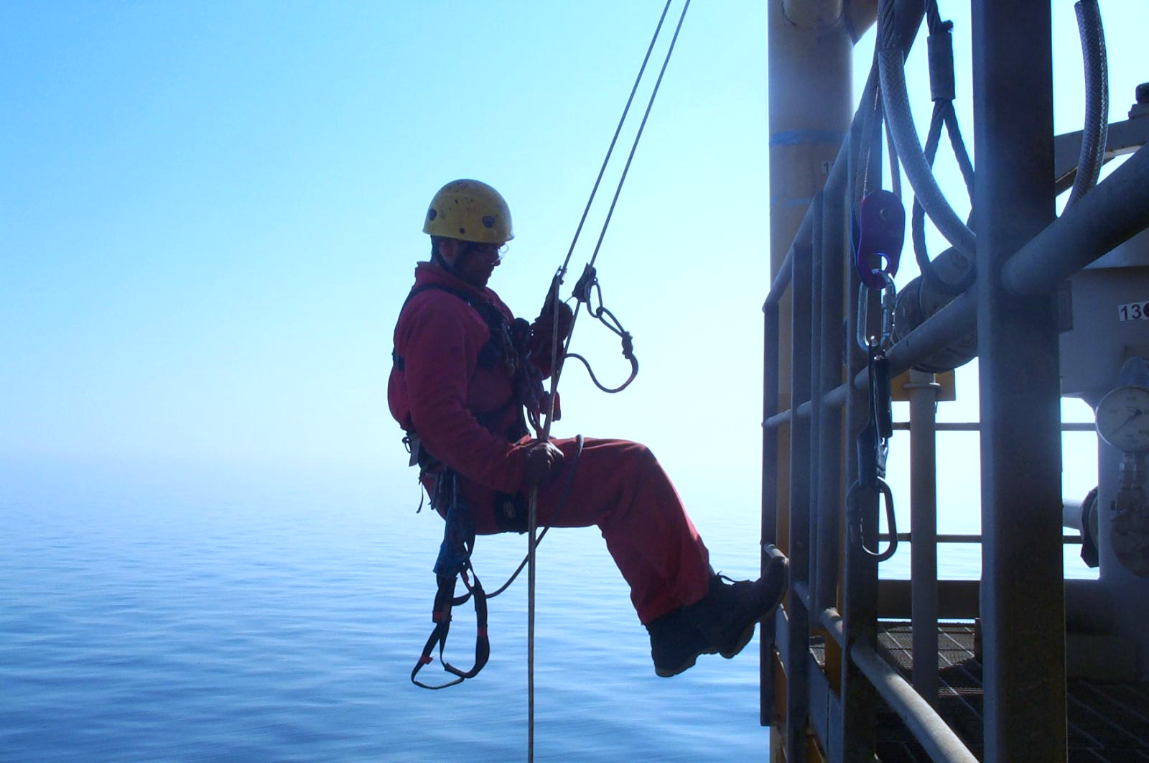
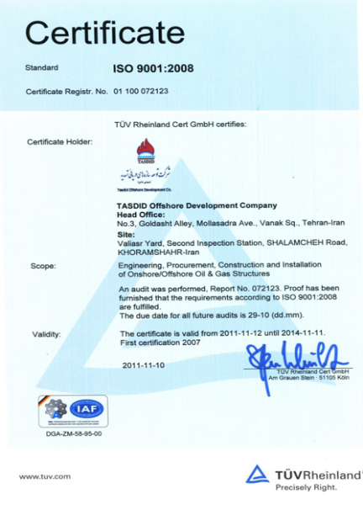
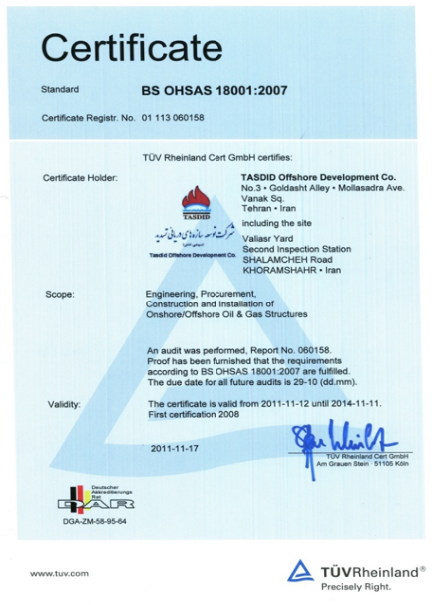
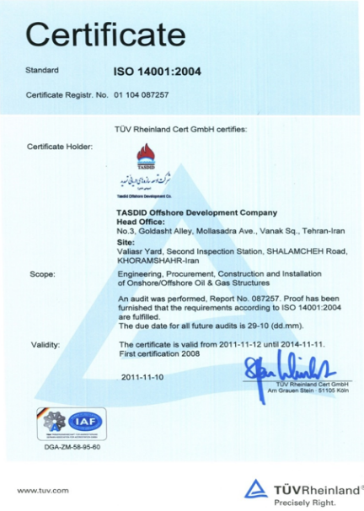
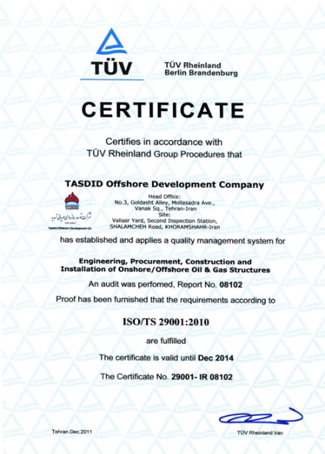
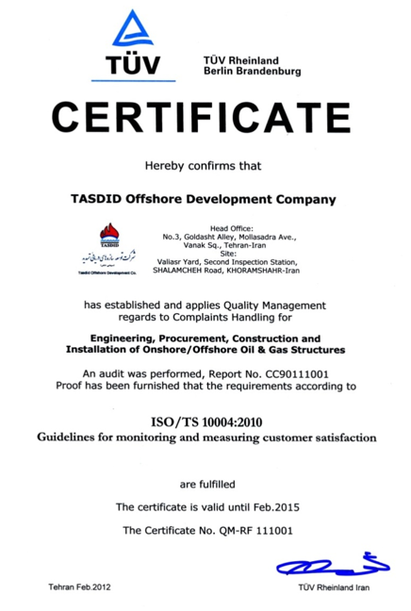
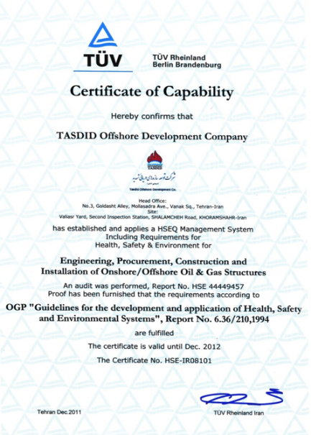
WHY TASDID
8 Million Man Hours Without a Major Incident

Slide 17
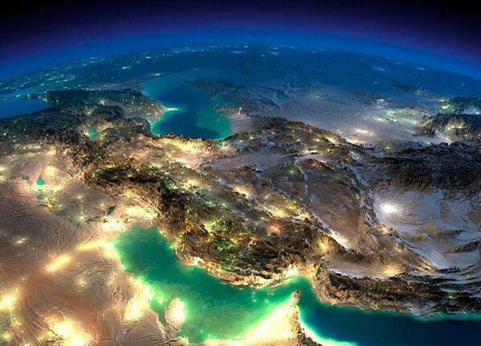
WHAT WE OFFER
TASDID is not only a reliable business partner, it is the golden gate to a newly opened and profitable Iranian market

Slide 18
Tehran’s Central Office:
No.24, St. Orfi Shirazi, North Sheikh Bahai Ave., Molla-Sadra
Office in Khorramshahr:
Vali-Asr Yard, the second bridge, Shalamcheh Road

